Slide 1
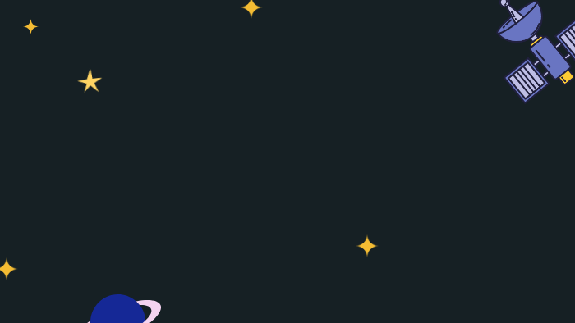




Kseniia Leshchenko, Victor Rebecq, Cathy Toomast

Slide 2


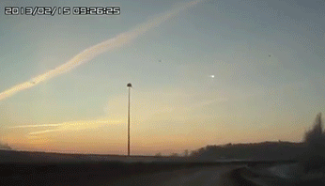
Goal of our analysis
predict where a meteorite lands
predict the class of a meteorite
Predict the mass of a meteorite
Example of meteorite seen falling in russia (2013)

Slide 3



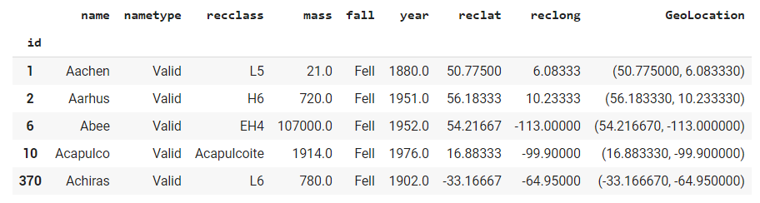
Data from NASA
Variables we have:
Name: specific name of the meteorite
Id: unique id
Nametype: valid if the meteorite where not degraded while falling
Class: 4 Major classes (L / H / LL / Other) divide into specific class
Mass: in grams
Fall: fell if observed falling / Found if not
Year: year of discovery
Geolocation (latitude / longitude): location where the meteorite was found

Slide 4
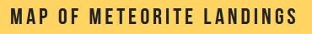
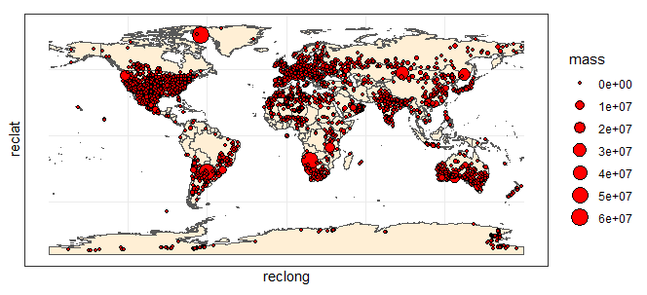

Slide 5
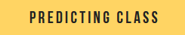
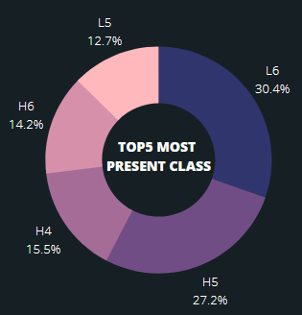
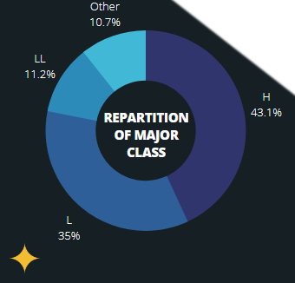

Slide 6
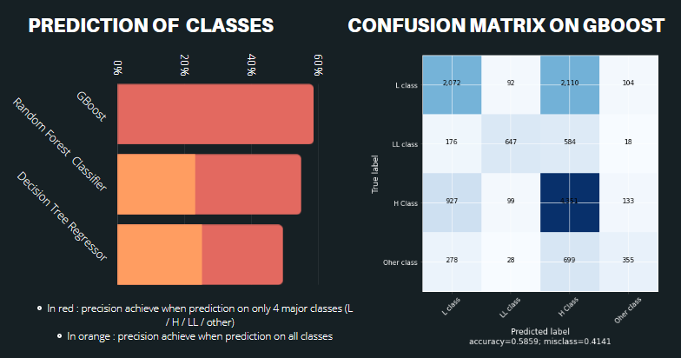


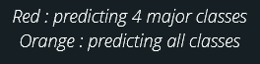

Slide 7
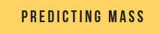
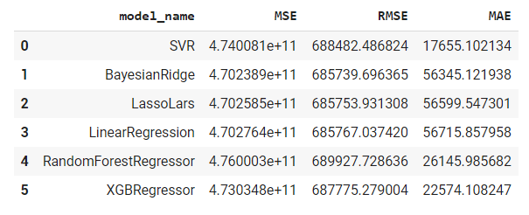
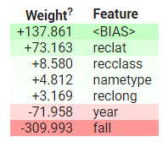

Best model: SVM Regressor
To sum up :
Can predict the mass with simple algorithms but MSE/RMSE/MAE still high
Support Vector Machine RegressoR is consider as the best algorithm to predict mass

Slide 8
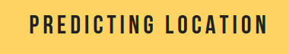
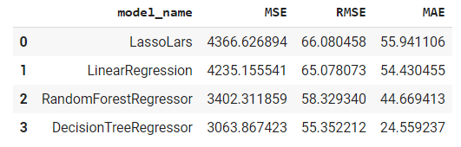
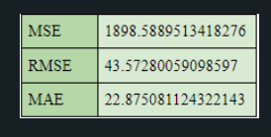
Best model:
Decision tree regressor
Most important features: year / Class / Mass
To sum up :
Can predict the location with simple algorithms but MSE/RMSE/MAE still high
Decision tree regressor is consider as the best algorithm to predict mass

Slide 9

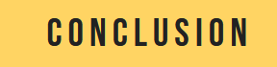
Finally:
We can predict the class of a meteorite with 60% of accuracy
We can predict the mass and the location but with a big MSE
We need more data to have a proper analysis. For now,we can suppose there is an uniform distribution of meteorite all around the globe

